Slide 1
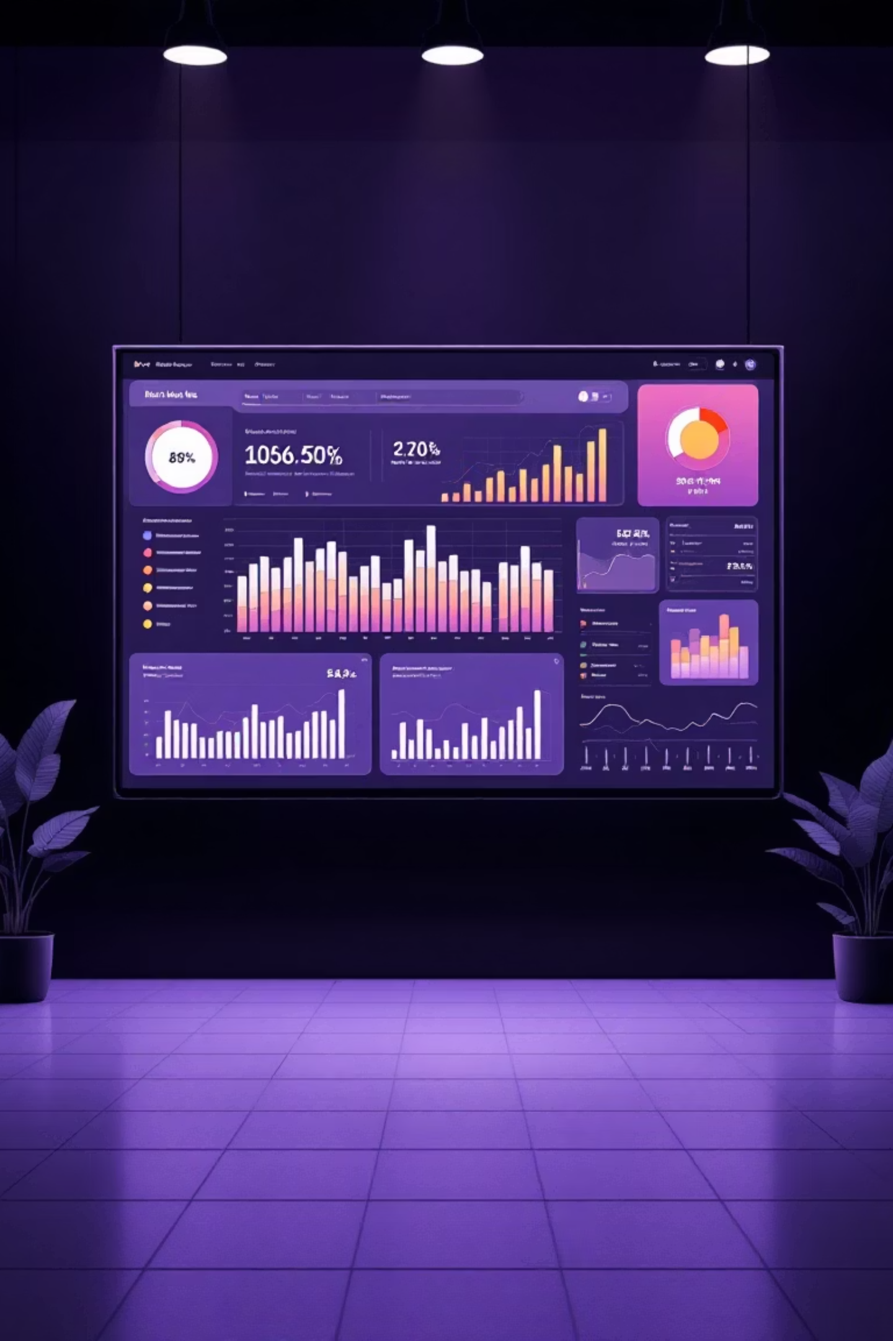

Customer Shopping Behavior Analysis
Analyzing 3,900 purchases to uncover insights into spending patterns, customer segments, and product preferences that drive strategic business decisions.

Slide 2
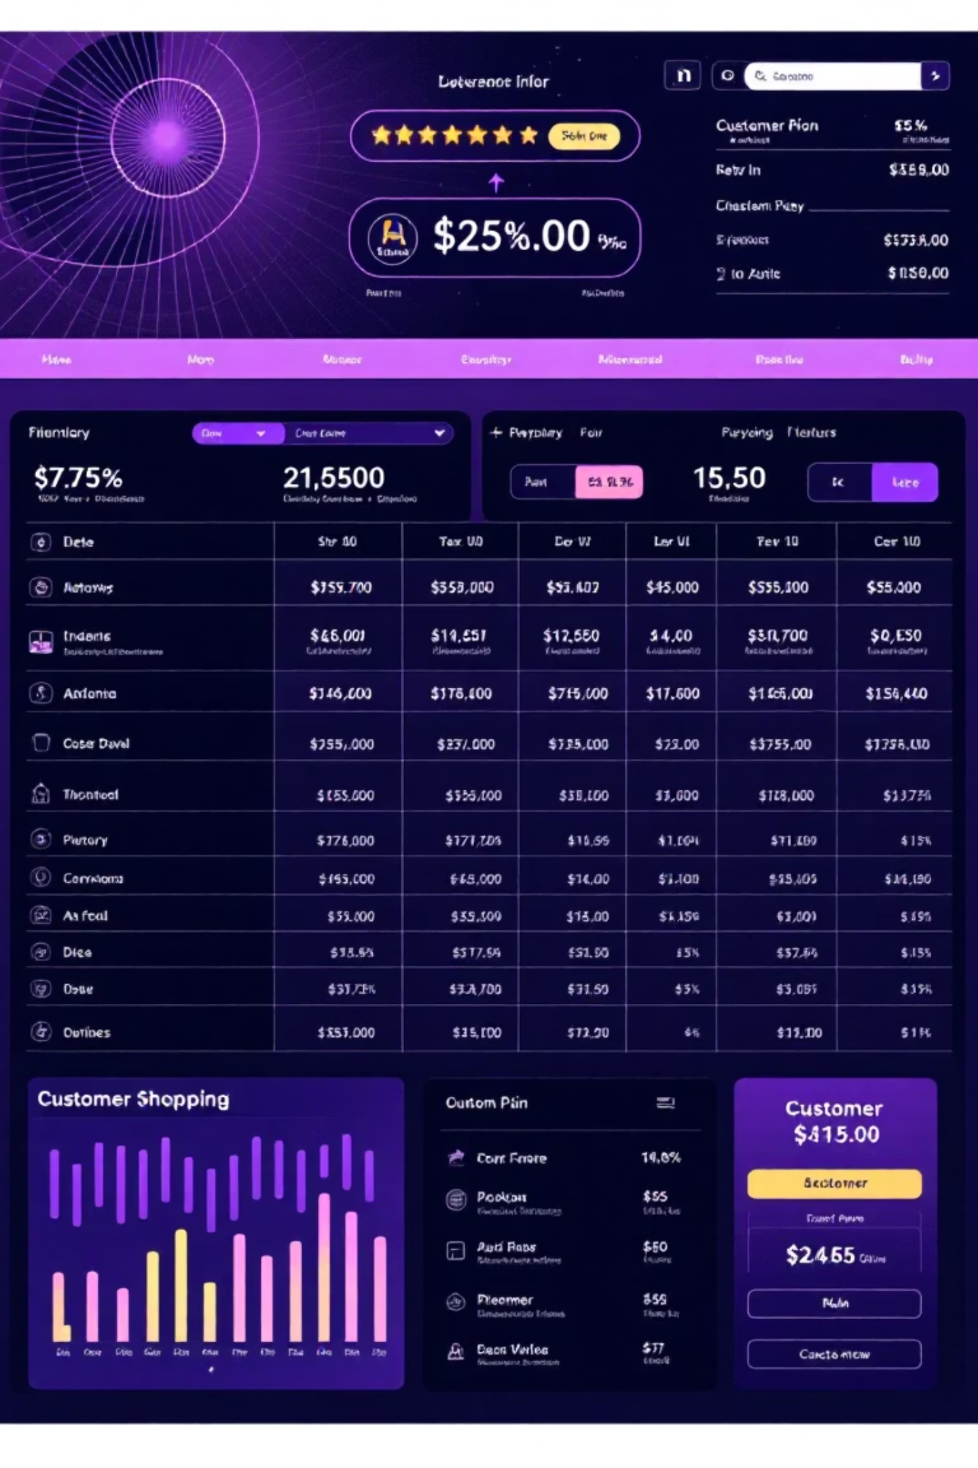
Dataset Overview
3,900
18
50
Total Purchases
Data Columns
Locations
Transactions analyzed across all categories
Comprehensive customer and purchase attributes
Geographic diversity in customer base
25
Product Types
Diverse inventory across categories
Dataset includes customer demographics, purchase details, shopping behavior metrics, and product information with minimal missing data (37 values in Review Rating).

Slide 3

Data Preparation & Cleaning
01
Data Loading & Exploration
Imported dataset using pandas, analyzed structure with df.info() and summary statistics
02
Missing Data Handling
Imputed Review Rating nulls using median rating per product category
03
Feature Engineering
Created age_group bins and purchase_frequency_days columns for deeper analysis
04
Database Integration
Connected to PostgreSQL and loaded cleaned data for SQL analysis

Slide 4
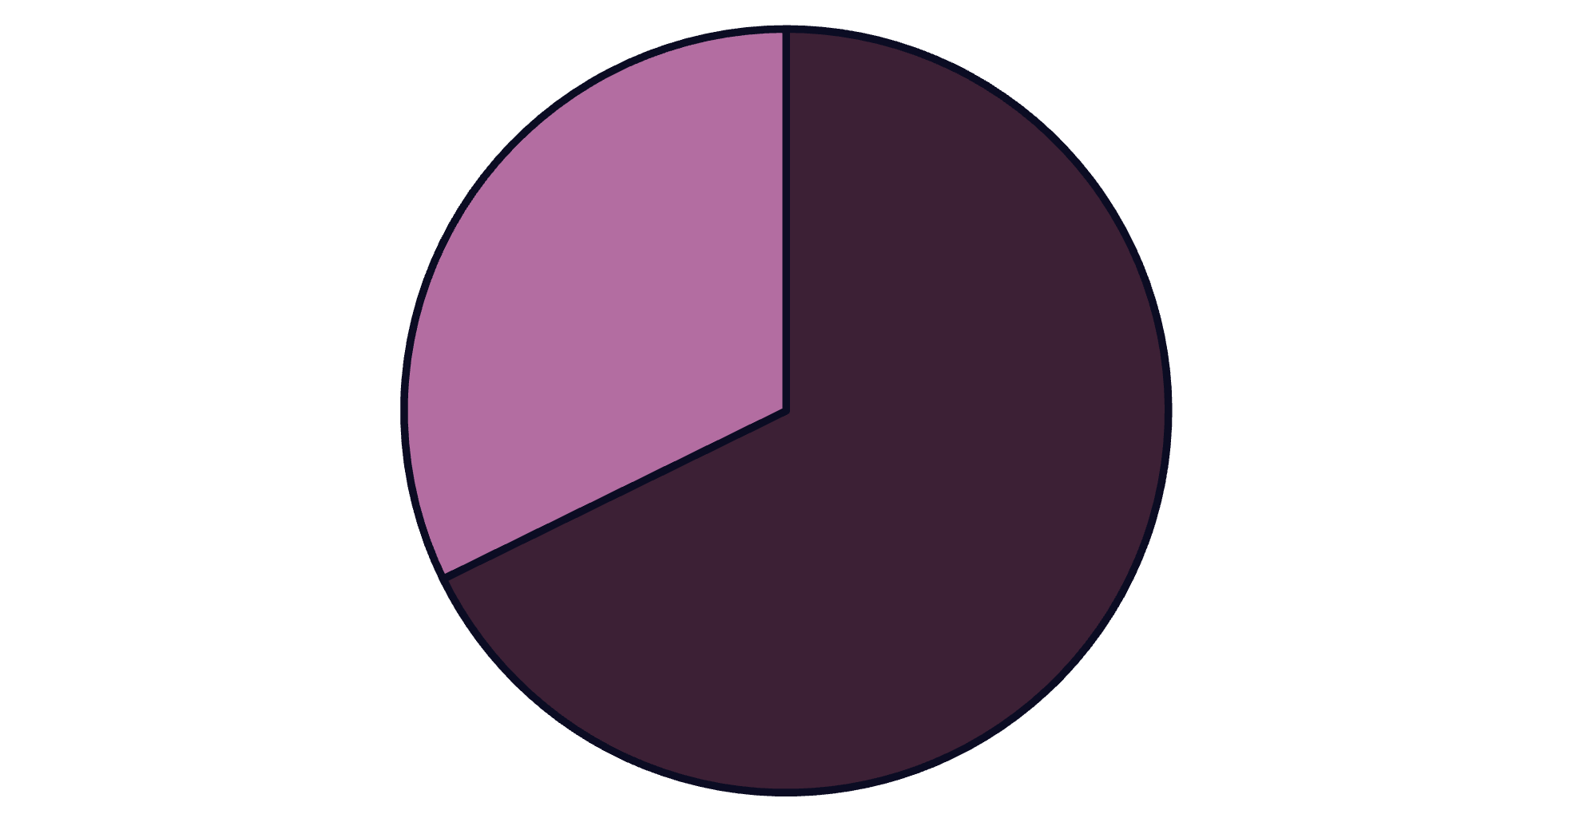
Revenue Insights by Gender
Male Customers Drive Revenue
Male customers generate 68% of total revenue ($157,890) compared to female customers at 32% ($75,191).
This significant gap suggests opportunities for targeted marketing to increase female customer engagement.
Male
Female

Slide 5
Product Performance Analysis
Gloves
Sandals
Boots
Top-rated at 3.86 average rating
Second highest at 3.84 rating
Strong performance at 3.82 rating
High-rated products show consistent customer satisfaction and should be featured prominently in marketing campaigns.

Slide 6



Shipping & Spending Patterns
Express Shipping
Average spend: $60.48
Premium shipping correlates with higher purchase amounts
Standard Shipping
Average spend: $58.46
Slight difference suggests shipping choice reflects customer urgency
Express shipping users demonstrate marginally higher spending, indicating potential for premium service upselling.

Slide 7
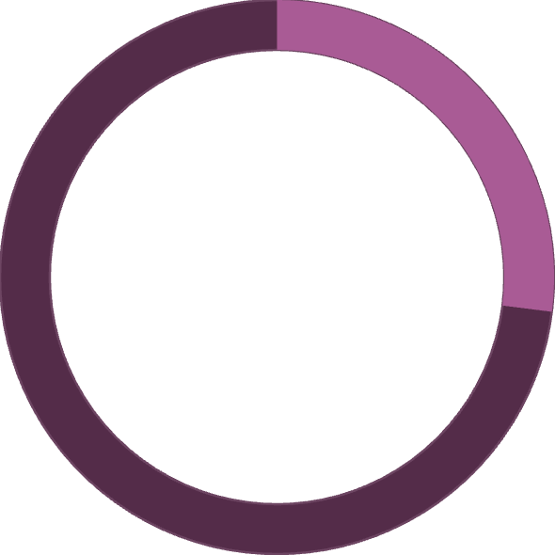

Subscription Status Comparison
Subscription Opportunity
Despite similar average spending, non-subscribers generate significantly more total revenue ($170,436 vs $62,645).
27%
Converting more customers to subscriptions could stabilize revenue streams.
Subscribers
1,053 customers with $59.49 avg spend
73%
Non-Subscribers
2,847 customers with $59.87 avg spend

Slide 8






Customer Segmentation
New
83 customers
Returning
701 customers
Loyal
3,116 customers
Strong loyal customer base (80%) indicates successful retention. Focus on converting new customers to returning status and returning to loyal.

Slide 9
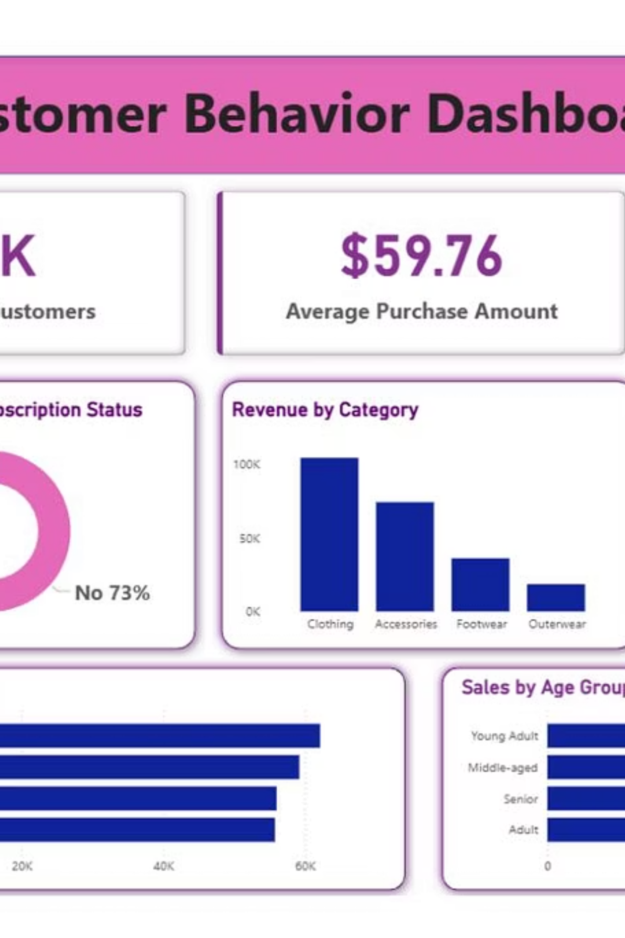
Interactive Dashboard
Power BI dashboard provides real-time visualization of key metrics including revenue trends, customer segments, product performance, and demographic insights for data-driven decision making.

Slide 10
Strategic Recommendations
1
2
3
Boost Subscriptions
Customer Loyalty Programs
Review Discount Policy
Promote exclusive benefits and rewards to convert the 73% non-subscriber base
Balance promotional sales boosts with margin control for profitability
Reward repeat buyers to accelerate movement into loyal segment
4
5
Product Positioning
Targeted Marketing
Highlight top-rated items (Gloves, Sandals, Boots) in marketing campaigns
Focus efforts on high-revenue demographics and express-shipping users

